Slide 1
CCSICT Digital Grading System
By
Cyrus Troy C. Bazar(@alieelinux)

Slide 2
Introduction
This project is a command-line system for managing student records. It stores grades, attendance, and exam scores, calculates overall grades, and predicts final performance using linear regression. The system also provides bar graph visualizations to help analyze student performance by course.

Slide 3
Purpose
Store and manage student records efficiently.
Calculate overall grades from quizzes, exams, and other assessments.
Predict final student performance using linear regression.
Provide visualizations by course to analyze performance trends.

Slide 4
System Overview
Command-Line Interface (CLI) system.
Stores student records in SQLite or CSV.
Consolidates multiple quiz and exam columns for accurate grade calculation.
Supports conversion between CSV and database formats.
Predicts final grades using linear regression.
Visualizes performance with bar graphs by course.

Slide 5
Core Functions
Create – add new student records.
Read – view stored records.
Update – modify existing records.
Delete – remove records using unique ID.
Input Validation – ensures data is in correct format.
Error Handling – manages runtime or database errors.
Menu & CLI Flow – simple numbered interface for easy navigation.

Slide 6
Data Analysis
Descriptive Statistics – summarize grades, attendance, and scores.
Aggregation – combine multiple quiz/exam columns for consistency.
Visualization – bar graphs per course using Matplotlib & Seaborn.
Trend Analysis & Prediction – linear regression predicts final grades.
Insight Reporting – highlights student performance patterns and trends.

Slide 7
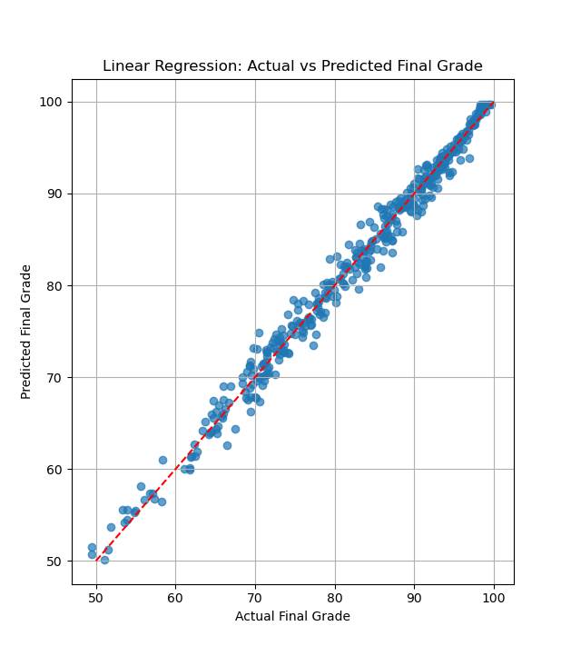
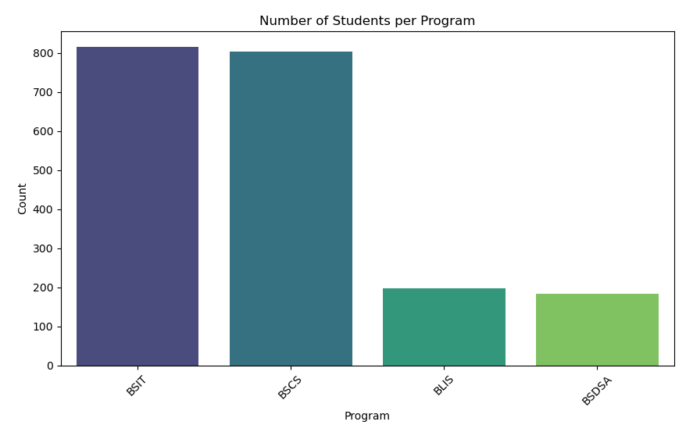
Result
Model dataset accuracy
Bar graph per course

Slide 8
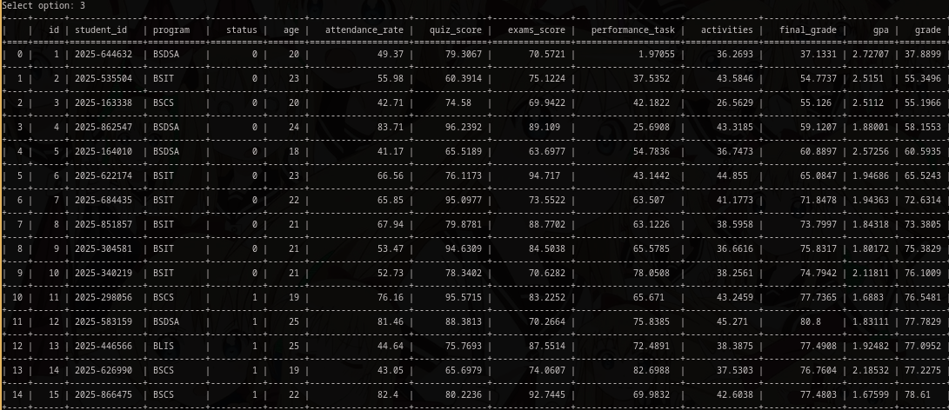
Result

Slide 9
Results
Bar graphs show student performance by course.
Tables summarize key metrics: quiz scores, exam scores, attendance, overall grades.
Linear regression predicts expected final grades based on current performance.
Figures and tables make trends and comparisons easy to understand.

Slide 10
Challenges & Lessons Learned
Dependency issues – managed by controlling Python library versions.
Logical errors & debugging – solved through step-by-step testing.
Database quirks – handled with proper SQL syntax and error handling.
CLI limitations – mitigated by a simple numbered menu interface.
Learned the importance of data preprocessing, visualization, and predictive modeling.

Slide 11
Challenges & Lessons Learned
Dependency issues – managed by controlling Python library versions.
Logical errors & debugging – solved through step-by-step testing.
Database quirks – handled with proper SQL syntax and error handling.
CLI limitations – mitigated by a simple numbered menu interface.
Learned the importance of data preprocessing, visualization, and predictive modeling.

Slide 12
Challenges & Lessons Learned
Dependency issues – managed by controlling Python library versions.
Logical errors & debugging – solved through step-by-step testing.
Database quirks – handled with proper SQL syntax and error handling.
CLI limitations – mitigated by a simple numbered menu interface.
Learned the importance of data preprocessing, visualization, and predictive modeling.

Slide 13
Conclusion
System effectively manages student records, calculates grades, predicts final performance, and visualizes results.
Future improvements:
Add a graphical interface for easier navigation.
Enable real-time grade calculation.
Expand visualization options beyond bar graphs.
Test on additional platforms like macOS.
Integrate more advanced predictive models and metrics.

Slide 14

Thank you For listening
Merry Christmas to atheists and from atheist

Slide 15

Me while coding my system

